Slide 1



CUSTOMER SEGMENTATION WITH K-MEANS CLUSTERING
Oleh : Arvio Abe Suhendar
01

Slide 2


PROBLEM STATEMENT
Customers buy products sometimes want to get an interesting purchase to get. But the company needs something that can happen and can be used as a strategy to improve marketing. Therefore, a grouping is carried out to be able to determine what kind of customers are in accordance with customer behavior. From this behavior, it can be done in various ways, such as there are discounts or members so that it can be right on target to increase business in the company. Therefore, clustering is used to divide customers into several groups with the help of AI and the K-Means Clustering algorithm.
02

Slide 3
OBJECTIVE
1
Grouping customers into groups
2
Providing conclusions from several customer groups
3
Providing strategies in terms of good business & marketing
03

Slide 4

DATASET OVERVIEW
Dataset : customer_segmentation.csv
Total Records : 2240
Demographics & Family Features :
- Id: Unique identifier for each individual in the dataset.
- Year_Birth: The birth year of the individual.
- Education: The highest level of education attained by the individual.
- Marital_Status: The marital status of the individual.
- Income: The annual income of the individual.
- Kidhome: The number of young children in the household.
- Teenhome: The number of teenagers in the household.
- Dt_Customer: The date when the customer was first enrolled or became a part of the company's database.
- Recency: The number of days since the last purchase or interaction.
- Complain: Binary indicator (1 or 0) whether the individual has made a complaint.
04

Slide 5
DATASET OVERVIEW
Product Purchase Features :
- MntWines: The amount spent on wines.
- MntFruits: The amount spent on fruits.
- MntMeatProducts: The amount spent on meat products.
- MntFishProducts: The amount spent on fish products.
- MntSweetProducts: The amount spent on sweet products.
- MntGoldProds: The amount spent on gold products.
- NumDealsPurchases: The number of purchases made with a discount or as part of a deal.
- NumWebPurchases: The number of purchases made through the company's website.
- NumCatalogPurchases: The number of purchases made through catalogs.
- NumStorePurchases: The number of purchases made in physical stores.
- NumWebVisitsMonth: The number of visits to the company's website in a month.
05

Slide 6

DATASET OVERVIEW
Marketing Response Feature :
- AcceptedCmp1 - AcceptedCmp5 : Binary indicator (1 or 0) whether the individual accepted the first - fifth marketing campaign.
- Z_CostContact: A constant cost associated with contacting a customer.
- Z_Revenue: A constant revenue associated with a successful campaign response.
- Response: Binary indicator (1 or 0) whether the individual responded to the marketing campaign.
06

Slide 7

TOOLS & LIBRARY
1
PYTHON
5
MATPLOTLIB
2
PANDAS
6
SEABORN
3
NUMPY
7
DATETIME
4
SCIKIT-LEARN
07

Slide 8
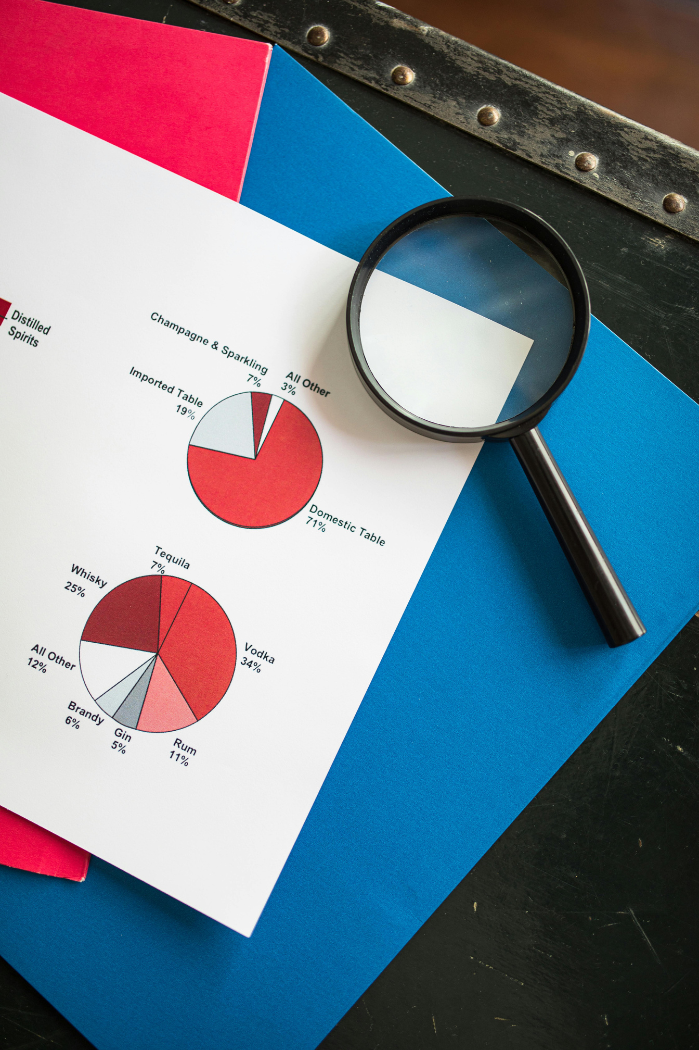


PREPROCESSING
DATA TYPE CHANGE
DATA DUPLICATION
MISSING VALUES
OUTLIER
ENCODING
SCALER
PCA
08

Slide 9
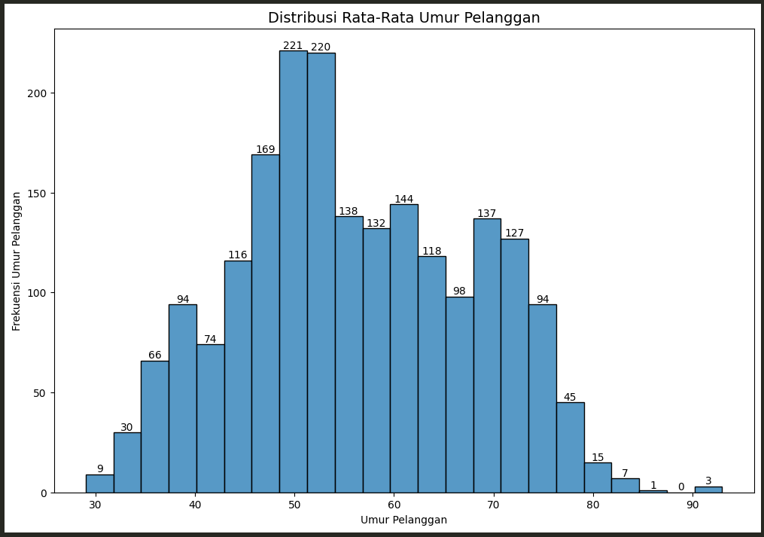
EXPLORATORY DATA ANALYSIS (EDA)
WHAT IS THE AGE DISTRIBUTION OF CUSTOMERS ?
At the age of 40 - 50 years is the age that most often makes transactions because at that time it is in the productive period and the work is mature so that there is already a decent income so that there are also more expenses. At the age of elderly such as 70 - 90 years old, transactions have decreased because they are usually retired from work so they have to save more expenses.
09

Slide 10
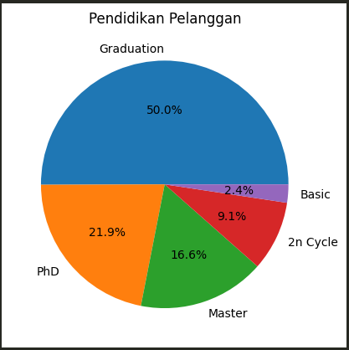
EXPLORATORY DATA ANALYSIS (EDA)
WHAT EDUCATION DO MOST CUSTOMERS HAVE ?
Most customers who make transactions are customers who have just graduated with a value of 50% or half of the data and usually already have sufficient expenses. For the least is the basic because usually at that time they still do not have an income and to make a purchase transaction most have to ask for money from their parents so that the expenses are less.
10

Slide 11
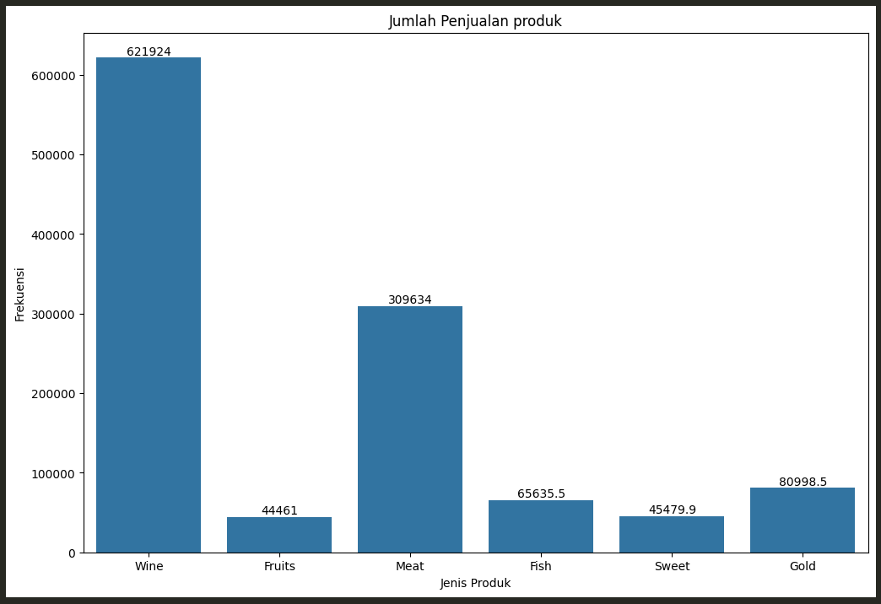
EXPLORATORY DATA ANALYSIS (EDA)
WHAT PRODUCTS DO CUSTOMERS BUY THE MOST ?
The most sales are products with the type of wine because most people like wine. The second is meat because meat is one of the food sources that are commonly eaten by many people. The least is the type of fruit because people don't like fruit where the taste can be sweet, sour, and bitter even though the nutrition is good and healthy.
11

Slide 12
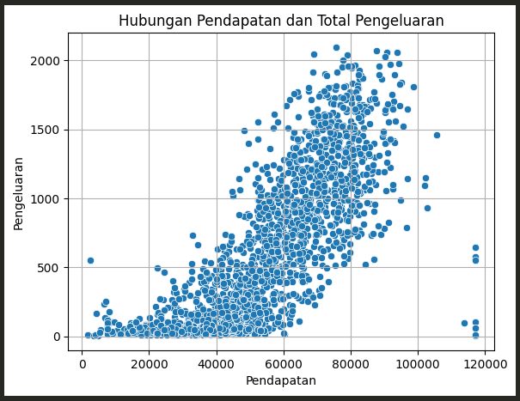
EXPLORATORY DATA ANALYSIS (EDA)
IS THERE A RELATIONSHIP BETWEEN CUSTOMER REVENUE AND TOTAL EXPENSES?
In a straight line graph, the higher the income, the higher the expenditure and if the income is low, the expenditure will also be low because it is necessary to save money.
12

Slide 13
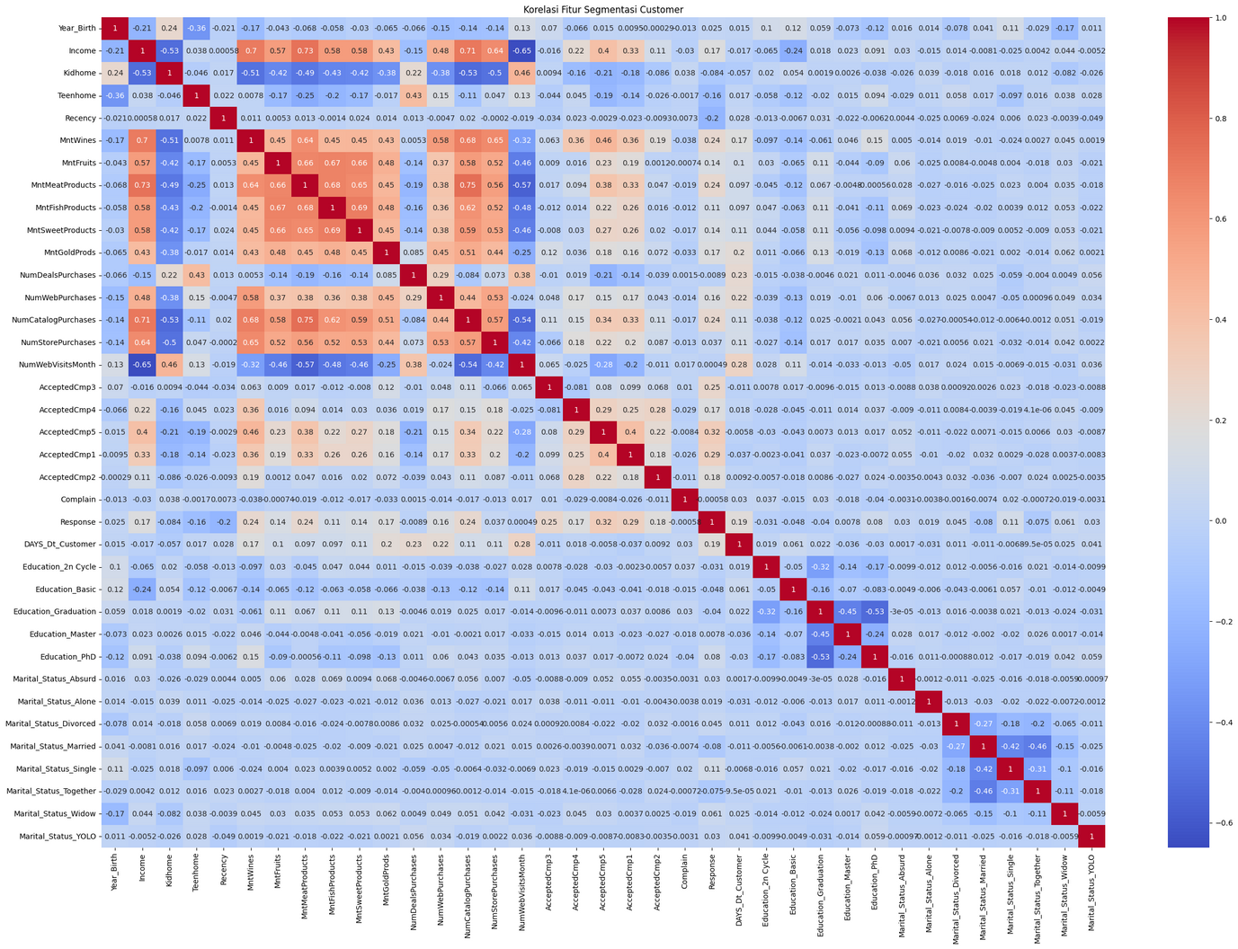
EXPLORATORY DATA ANALYSIS (EDA)
BASED ON THE CORRELATION RESULTS, WHICH FEATURES ARE THE MOST CORRELATED ?
There are correlated features are some products sold such as fish, gold, fruit, and others because these products can be added together to determine the total price of all products purchased. The income feature also shows some correlations such as rising income will also buy more often from the catalog, but less often to view the company's website.
12

Slide 14
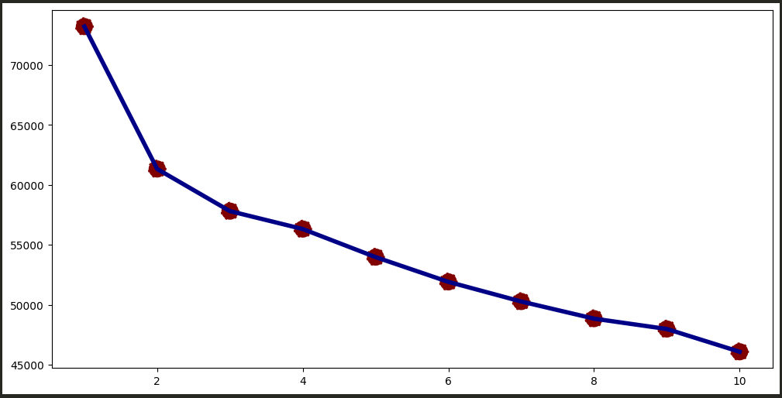
DETERMINING THE NUMBER OF CLUSTERS
ELBOW METHOD (INERTIA)
There is a slightly sharp elbow at a value of 2 or 3 which is useful as a reference for determining the number of clusters to be used
14

Slide 15
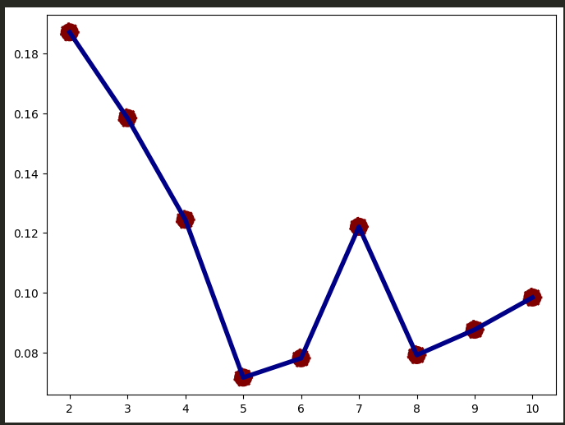
DETERMINING THE NUMBER OF CLUSTERS
SILHOUETTE SCORE
From the results on the silhouette score graph, it can be determined that the cluster can be 2 or 3 because both values ​​are the highest on the graph. But in terms of customer segmentation, it will take 3 clusters because if with 2 clusters it is too simple and only like the customer is active and inactive.
15

Slide 16
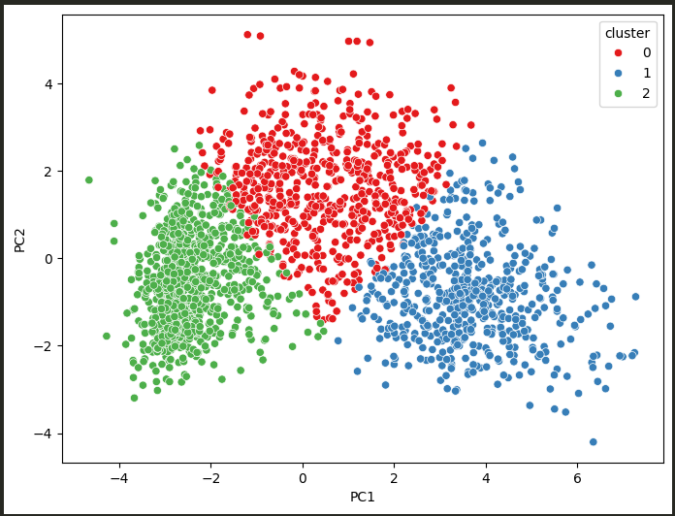


CLUSTER VISUALIZATION
After determining the division of clusters into 3, a scatterplot graph can be obtained and it has been successful in separating each customer group into 3 clusters.
16

Slide 17
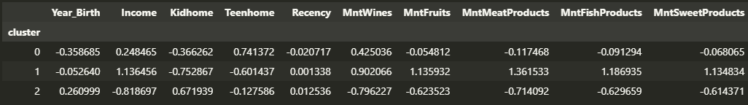
THE CLUSTER RESULT
Based on the cluster division, it has been divided into:
- Cluster 0 : Customers who have many children, moderate income, and moderate product purchases. Cluster 0 is for customers with families and can be given for family promos.
- Cluster 1 : Customers with large incomes and high product purchases. Cluster 1 is for premium customers and can be given exclusive products.
- Cluster 2 : Customers who have low incomes, and few product purchases. Cluster 2 is for frugal customers and can be given price discounts.
17

Slide 18
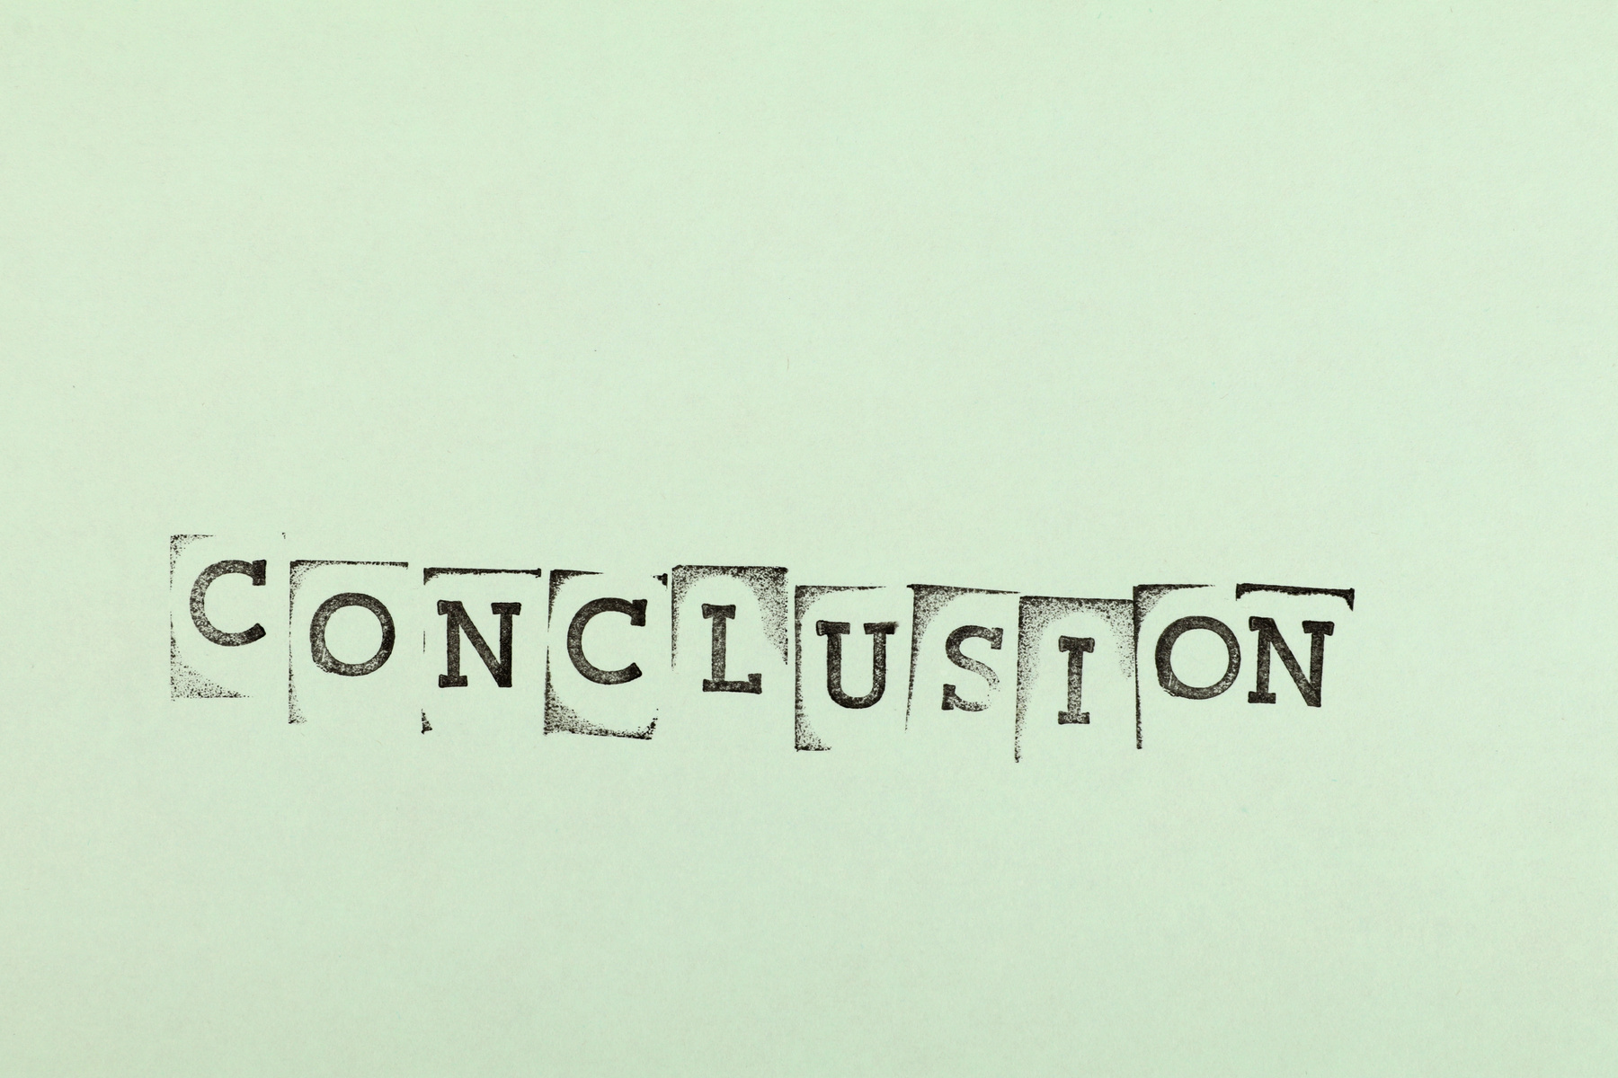
CONCLUSION
The conclusions that can be obtained include:
With 3 clusters, it can provide meaning to each customer group
Each customer group can be given their own insights to improve business & marketing
K-Means Clustering can identify customer patterns so that they can be grouped accordingly
18

Slide 19

FUTURE WORK
Development can be done by anyone. Can do such as:
Using larger data
Building views in streamlit
19

Slide 20
ABOUT ME
I am currently learning and building a career in AI/ML. This project is my practice to build a simple python application. I want to further develop my skills in this field through existing projects.
Linkedin :
ARVIO ABE SUHENDAR
Email :
4rv10suhendar@gmail.com
Github :
arvio1378
20

